Slide 1
The Chemistry of Biology
Life depends on chemistry!
© Amy Brown – Science Stuff

Slide 2
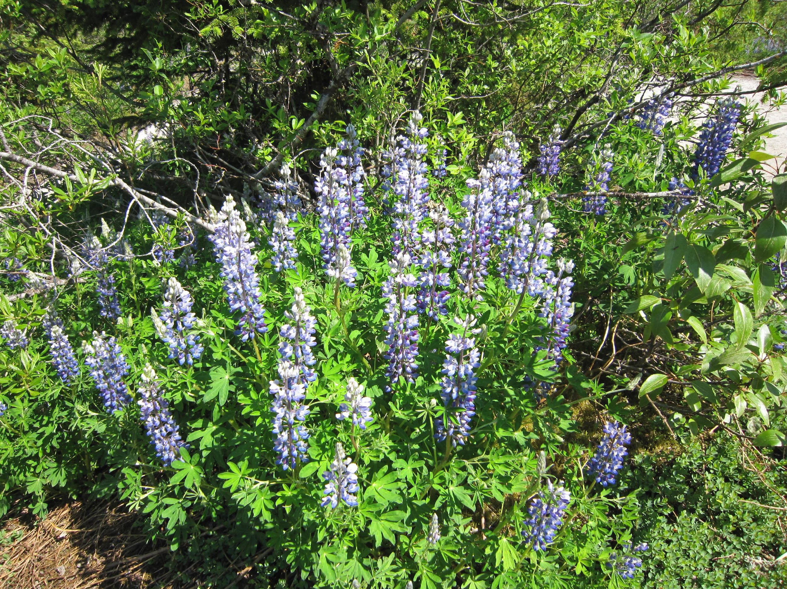
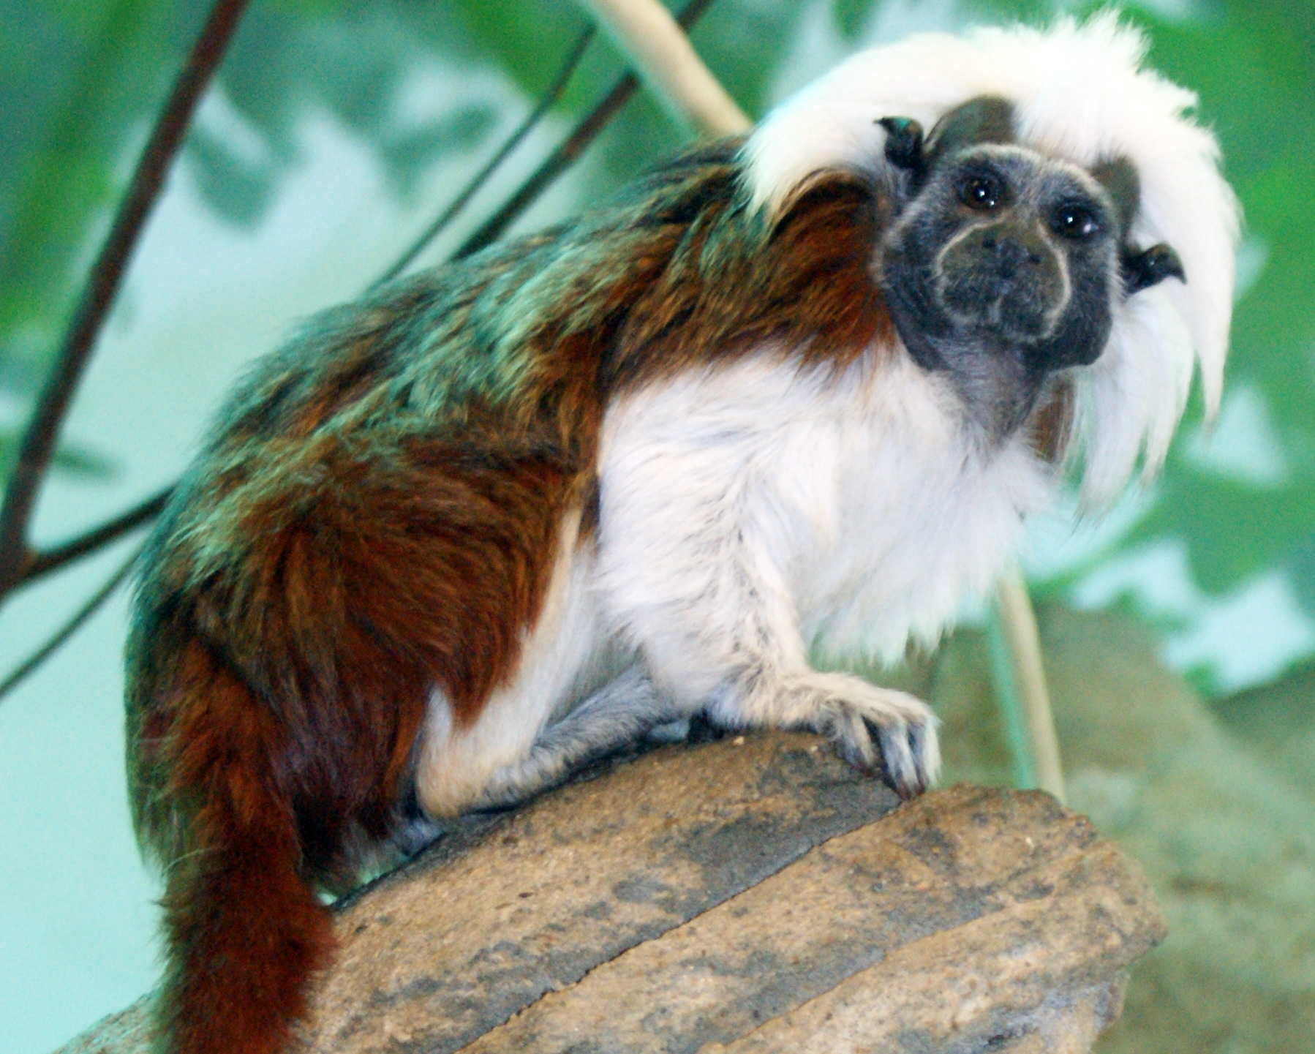
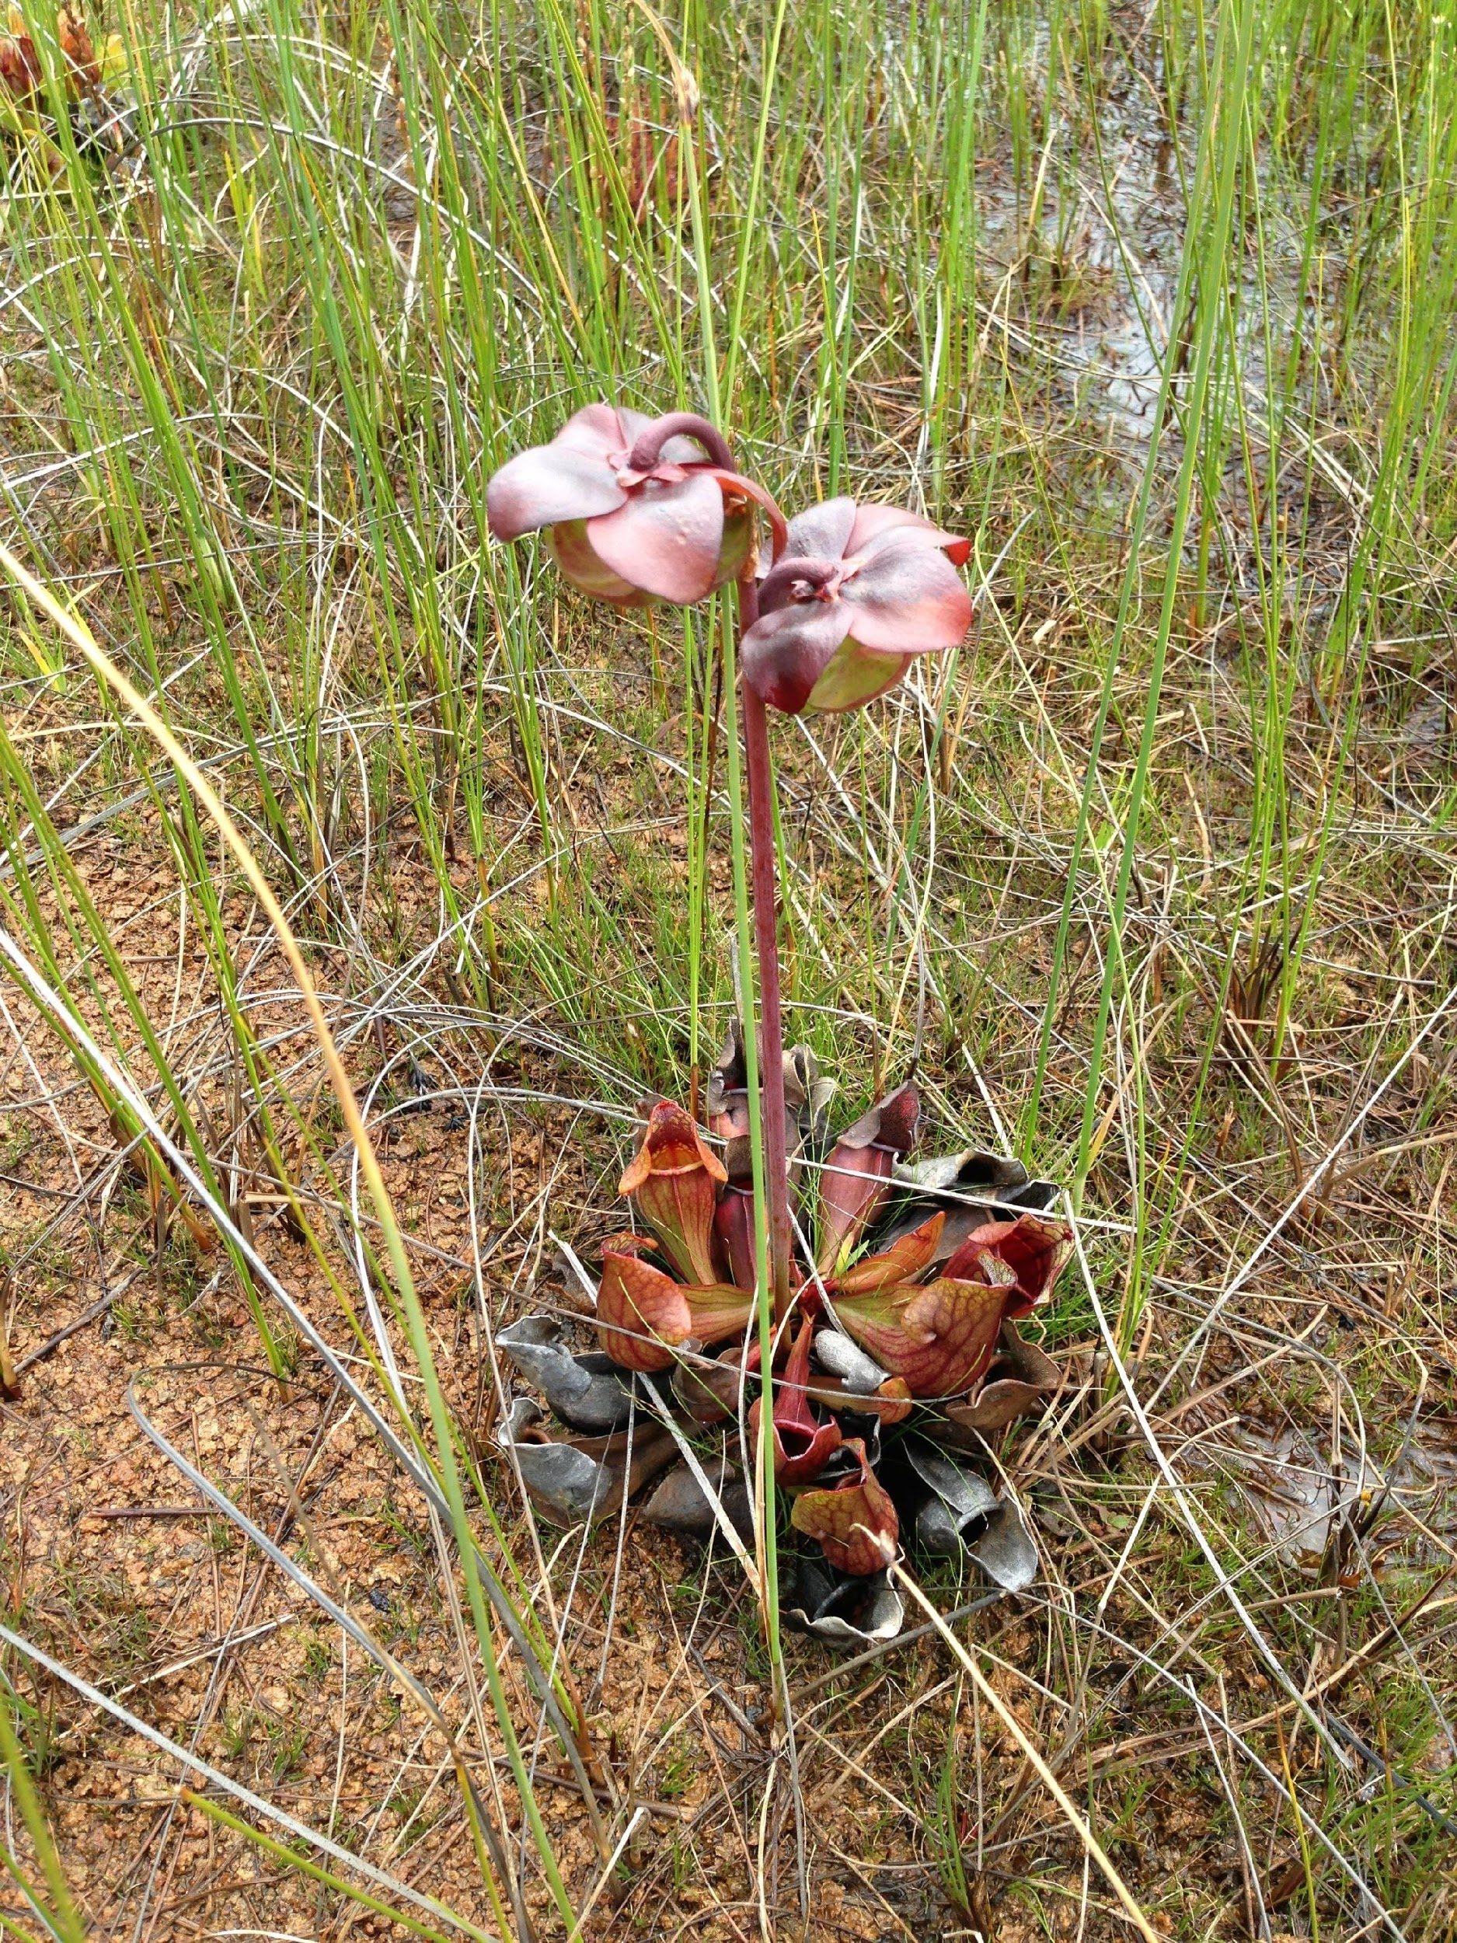
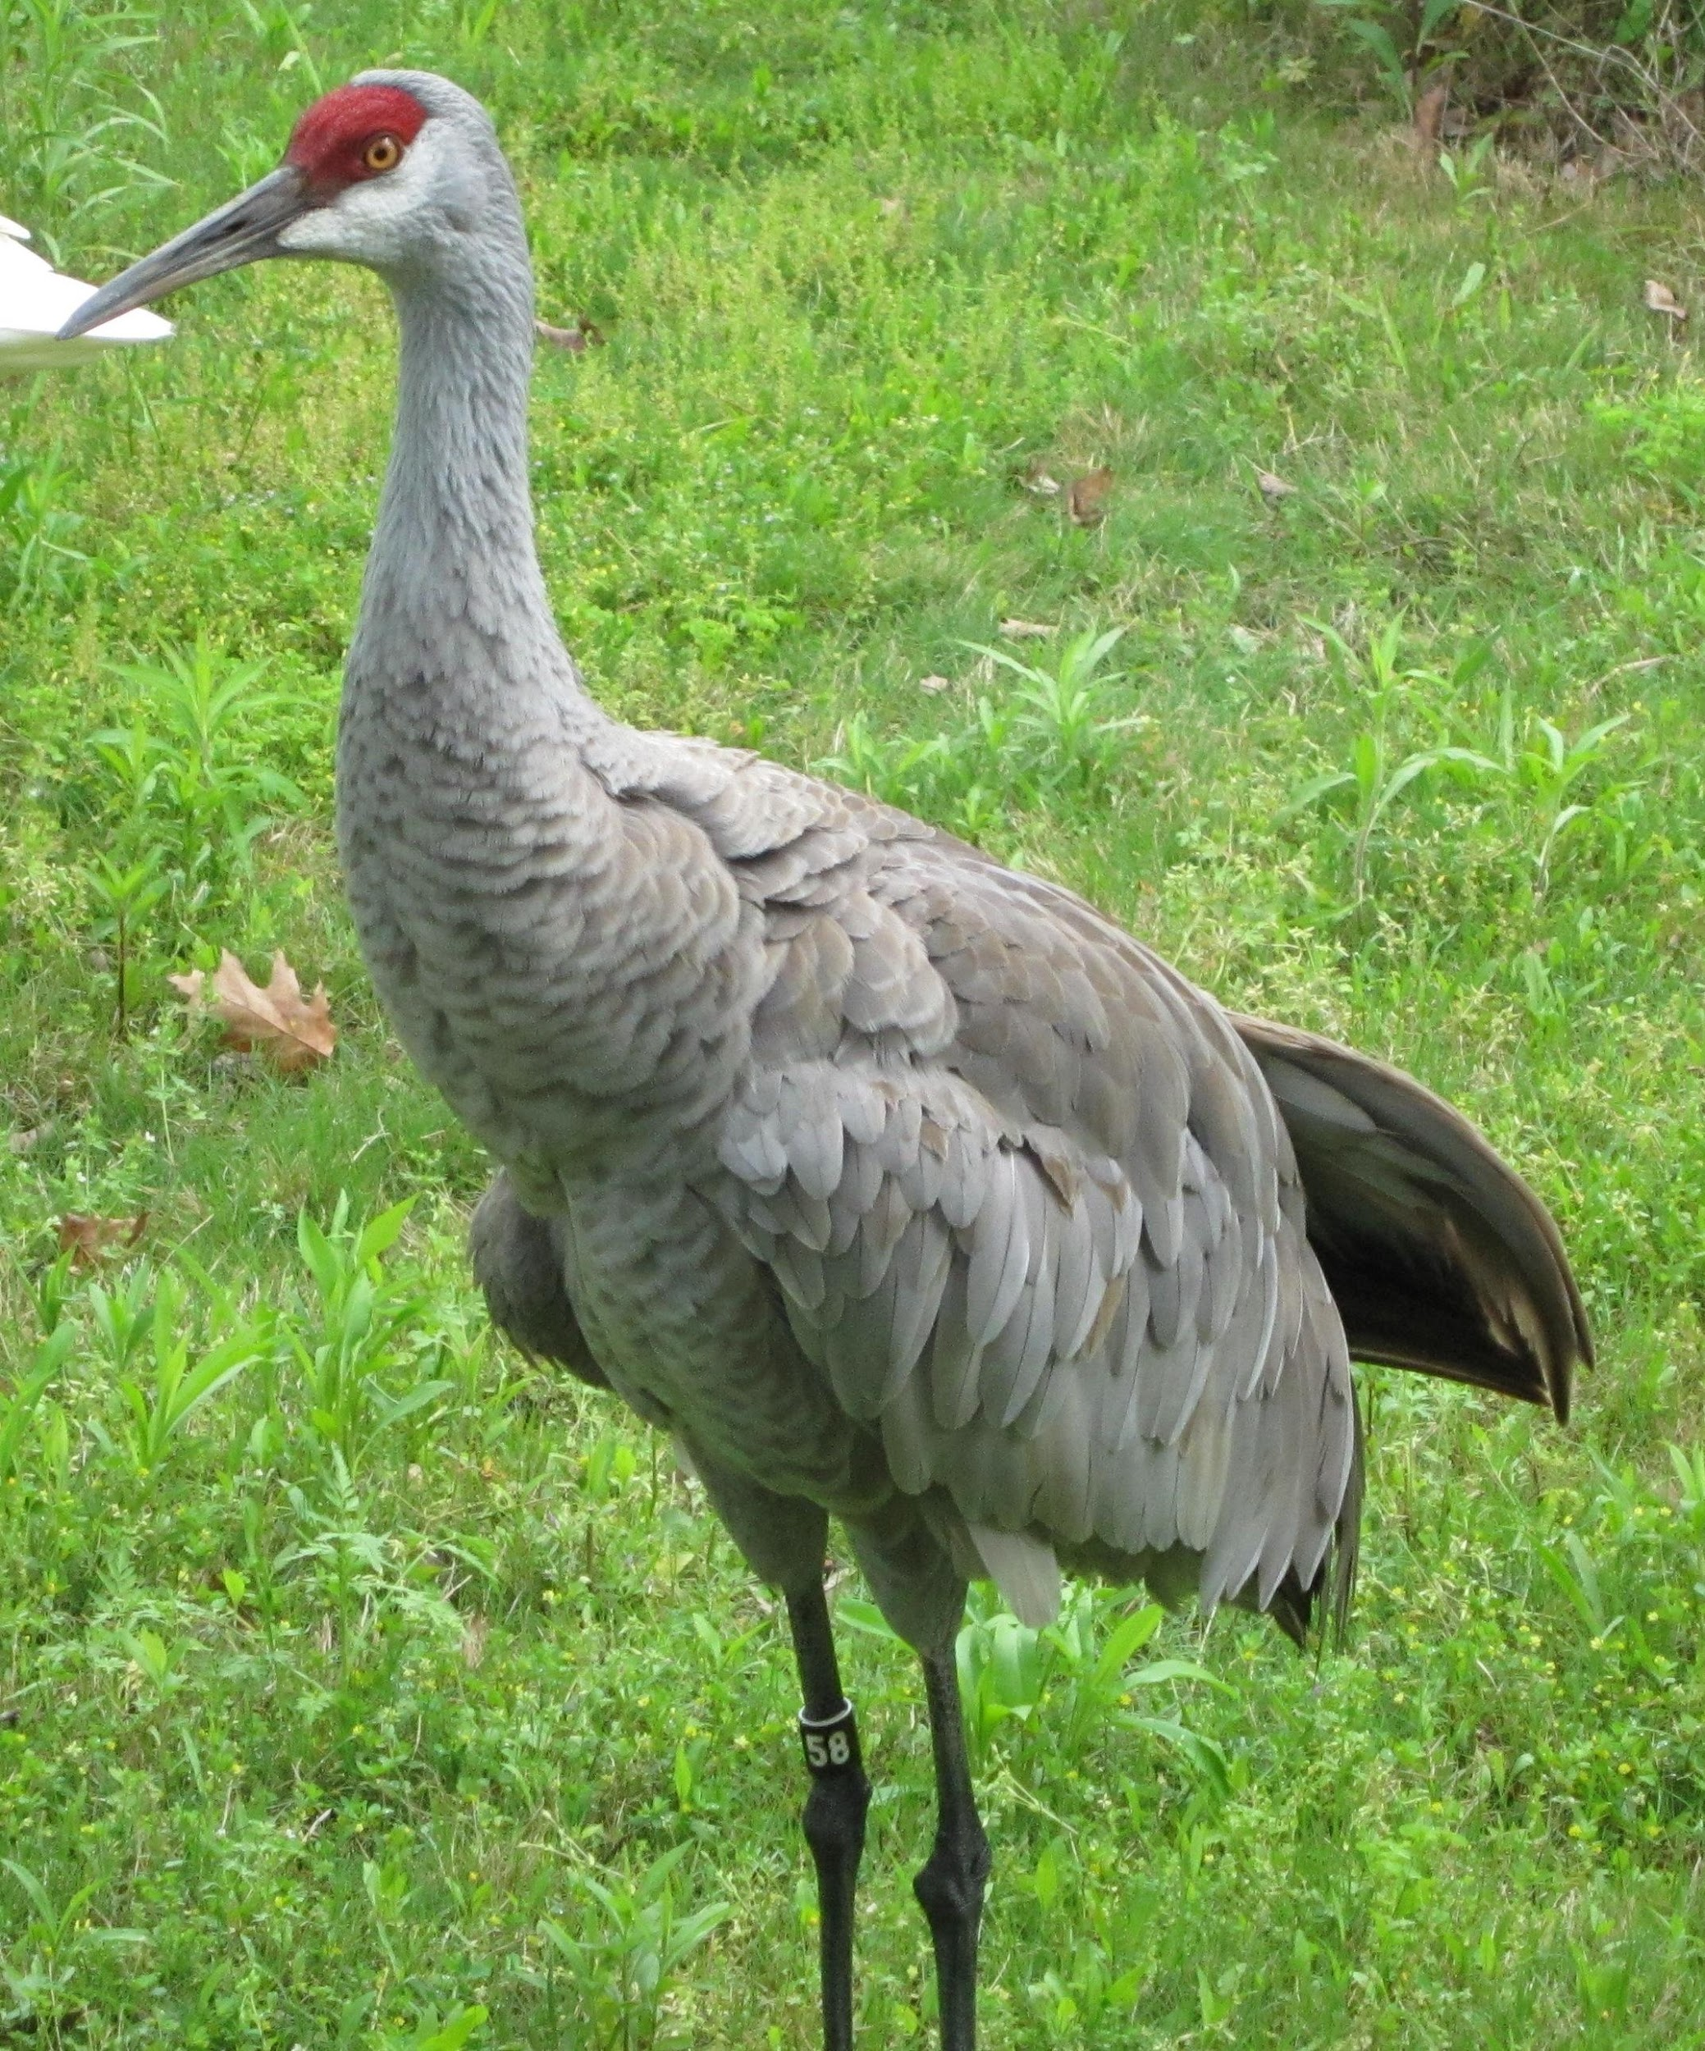
Life depends on chemistry.
Living things are composed of chemical compounds.
In order to understand biology, one must first understand the chemistry of life.

Slide 3
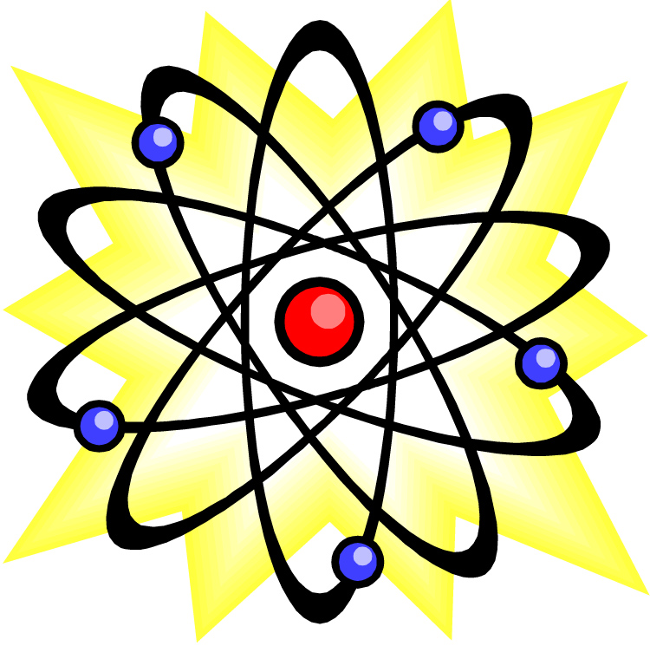
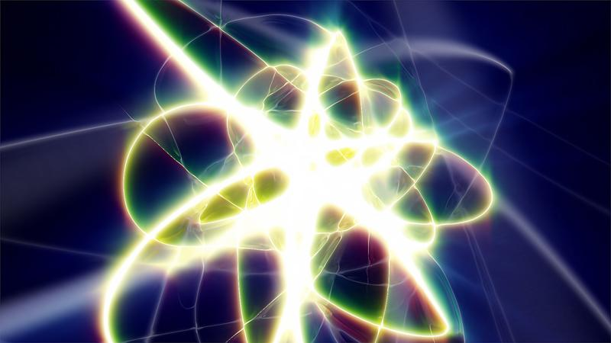
The Atom
1. An atom is the basic unit of matter.
2. The atom is the smallest particle of a substance that still retains the properties of that substance.
3. Atoms are composed of subatomic particles:
Protons, neutrons, and electrons.
4. Protons and neutrons have about the same mass and together form the nucleus of the atom.
5. Electrons have a mass of about 1/1840th the mass of a proton and are in constant motion in the space surrounding the nucleus.

Slide 4
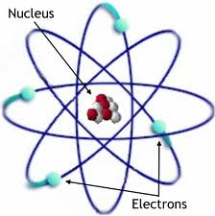
The subatomic particles have charges:
Protons have a positive charge.
Electrons have
a negative charge.
Neutrons have no charge.

Slide 5
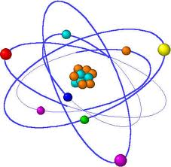
Elementssong
An element is a pure substance consisting of all the same type of atom.
There are more than 100 known elements, but only about 20-24 are commonly found in living organisms.

Slide 6
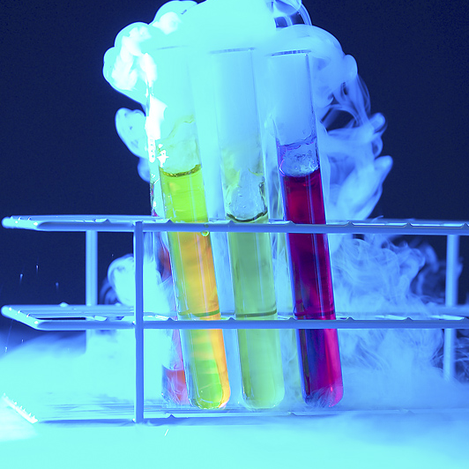
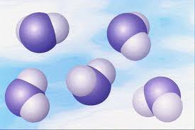
Compounds
A compound is the chemical combination of two or more elements in definite proportions.
For example: The formula of water is H₂O. There are 2 hydrogen atoms bonded to one oxygen. This definite ratio is always present in water.

Slide 7
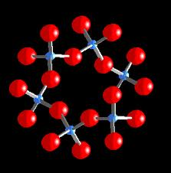
The atoms that compose compounds are held together by chemical bonds.
video
Bond formation always involves the _________ that surround the nucleus of each atom.
electrons
Chemical Bonds
There are two main types of bonds:
Ionic
Covalent

Slide 8
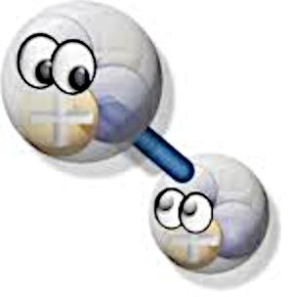
An ionic bond is formed when one or more electrons are:
transferred from one atom to another.
Bonds
When electrons are gained or lost, ions are formed. Ions are atoms that have either gained or lost electrons.
Ionic

Slide 9
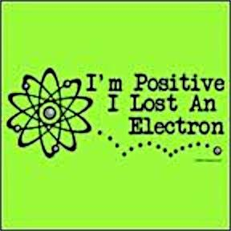
If an atom loses electrons, it will then have a ________ charge.
positive
If an atom gains electrons, it will then have a_______ charge.
negative

Slide 10
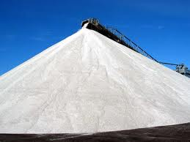
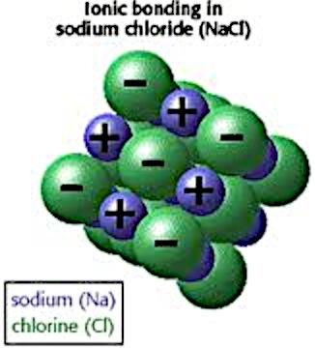
An ionic bond is formed when ….
…. ions of opposite charges are attracted to one another.
For example: Sodium tends to lose an electron and becomes a Na⁺ ion. Chlorine tends to gain one electron and becomes a Cl– ion. These two ions are then attracted to one another because they have opposite charges. The compound NaCl is formed.
The attraction between oppositely charged ions is an ionic bond.

Slide 11
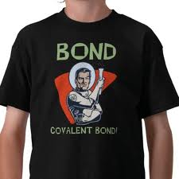
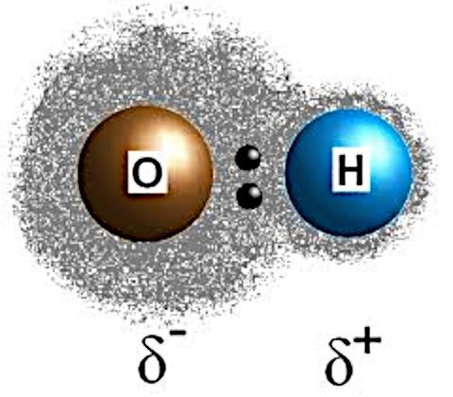
Covalent Bonds
Sometimes electrons are _________ between atoms instead of being transferred.
shared
When electrons are shared between two atoms, the shared electron spends time traveling around the nuclei of both atoms.

Slide 12
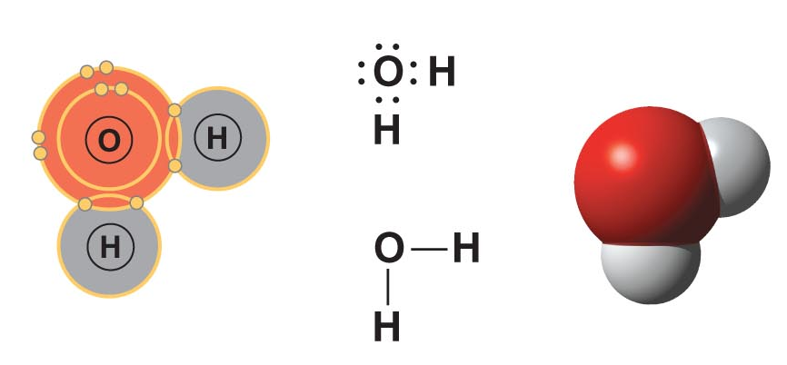
A covalent bond is formed when electrons are shared between atoms.
For example: In a water molecule, each hydrogen atom shares electrons with the oxygen atom.
The shared electrons spend part of the time traveling around the _________ nucleus and part of the time traveling around the _______ nucleus.
hydrogen
oxygen
When atoms are joined together by covalent bonds, __________ are formed. A molecule is the smallest unit of a compound.
molecules

Slide 13
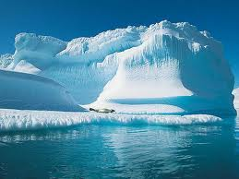
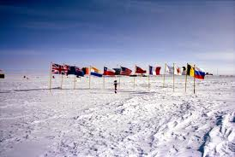
Video
Polar Molecules
Polar molecules don’t have anything to do with cold temperatures, but these molecules do have opposite ends …. Or poles!
North Pole
South Pole
When covalent bonds are formed between atoms of different elements, there are different degrees of ….
In covalent bonds formed between atoms of different elements, the electrons are not ….
Some atoms have a stronger attraction for electrons than do other atoms. As a result, the electrons are not shared equally.
….shared equally between the atoms involved.
… attraction for the shared electrons.

Slide 14
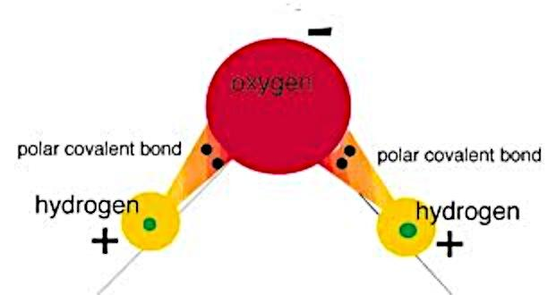
Polar Covalent Bonds:
Covalent bonds in which electrons are shared unequally resulting in a molecule which has poles -- part of it is negative and part of it is positive.
The atom around which the electrons spend the most time will have a _______________ charge, and the atom around which the electrons spend the least time will have a ______________ charge.
slightly negative
slightly positive

Slide 15
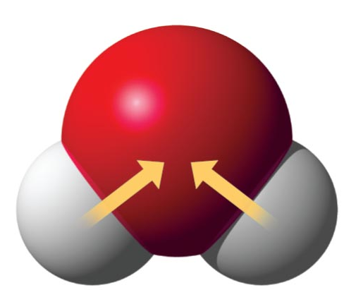
In a water molecule, oxygen has a _________________ for the shared electrons. The shared electrons spend more time around the ________ atom, so the oxygen atom has a ______________ charge.
stronger attraction
oxygen
slightly negative
The shared electrons spend less time around the ________
atom, so the hydrogen atom has a ___________ charge.
− −
Oxygen
hydrogen
slight positive
Hydrogen
Hydrogen
+ +
A water molecule is: polar because one end is positive and one end is negative.

Slide 16
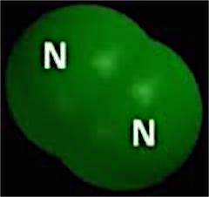
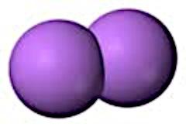
Nonpolar Covalent Bond: The electrons are shared _______. These bonds exist between identical atoms such as H₂, Cl₂, O₂, and N₂.
equally
O O

Slide 17


Water – We Can’t Have Life Without it!
The polarity of water is so important! Let me say this one more time!!
In a water molecule, an oxygen atom has a much _________________ for electrons than does the hydrogen atom. At any given time, there is a greater probability of finding the shared electrons near the _________ atom than near the ___________ atom.
stronger attraction
oxygen
hydrogen
As a result, the oxygen end of the molecule has a slight negative
charge and the hydrogen end of the molecule has a slight positive charge.
A molecule that is positive at one end and negative at the other end is called a polar molecule.
A water molecule is polar because there is an uneven distribution of electrons between the oxygen and hydrogen atoms.

Slide 18
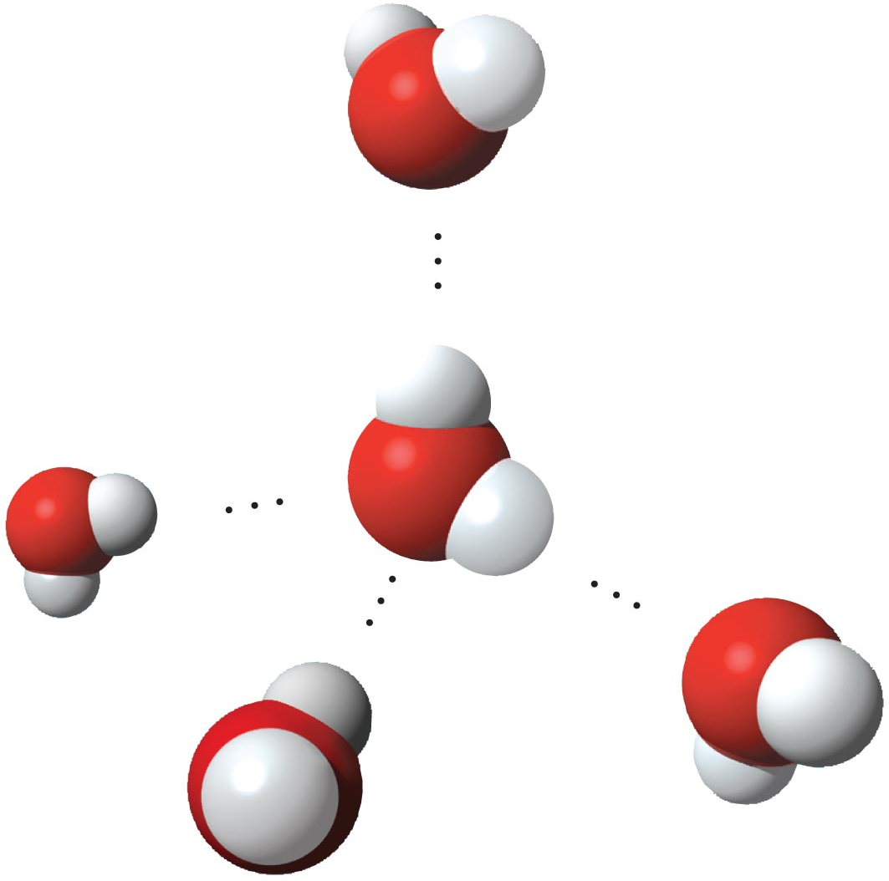
Hydrogen Bonding
Water molecules stick together because the opposite charges of the molecules attract one another.
<----- Water molecule
<------ Hydrogen Bond
The attraction between the oxygen
of one water molecule and the hydrogen of a different water molecule
forms a hydrogen bond.
This force of attraction forms hydrogen bonds.
A single water molecule can form up to 4 hydrogen bonds with other water molecules are the same time. This is responsible for many of the unusual properties found in water.

Slide 19

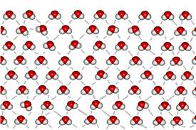
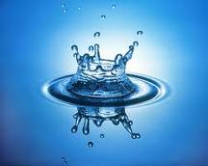
I am finally getting to the point!! Let me tell you about cohesion and adhesion!
Cohesion is:
The attraction between molecules of the same substance.
Water molecules stick to one another because of cohesion.
Adhesion is:
When water sticks to other substances beside itself, it does so because of adhesion.
an attraction between molecules of different substances.

Slide 20
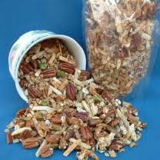
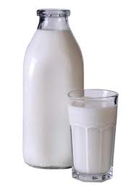
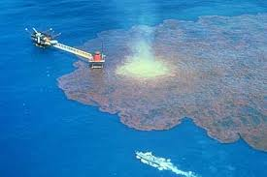
Solutions
and
Suspensions
Mixture:
A substance composed of two or more elements or compounds that are physically mixed together but are not chemically combined.
Homogeneous Mixtures:
The parts of the mixture are very evenly mixed.
Heterogeneous Mixture
The parts of the mixture are unevenly mixed such as in oil mixed with water.

Slide 23
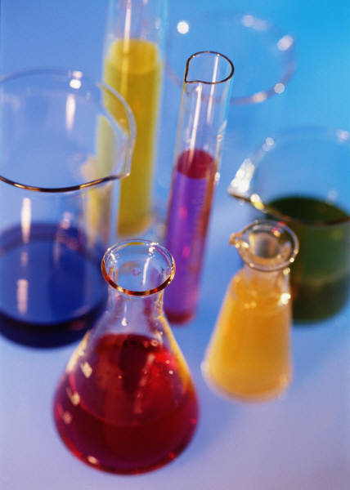
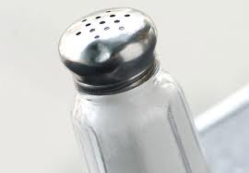
A solution is a homogeneous mixture. The parts of the solution are evenly mixed.
The two parts of a solution are:
Solute:
the substance that is dissolved
Solvent:
the substance that does the dissolving.
For example: Salt crystals will dissolve when placed in water. Salt is the solute and water is the solvent.

Slide 24
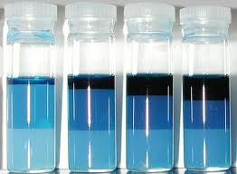
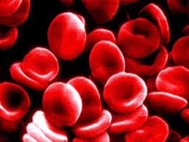
S
U
S
P
E
N
S
I
O
N
S
Suspension:
A mixture of water and undissolved materials
Example:
Your blood is a suspension.
Some materials do not dissolve in water, but separate into pieces so small that they do not settle out. These small pieces remain undissolved and are “suspended” in the solution.

Slide 25
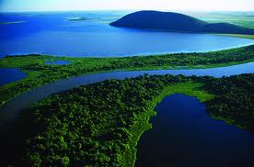
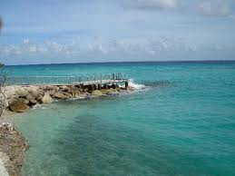
Water Makes Life on Earth Possible
Without water, life on Earth would not be possible. Here are the reasons why life on Earth is dependent on water.
Water is ________. This means that water molecules like to _____
________. At a wide range of temperatures, this sticking together of water molecules makes water ______. If the temperature gets too high, ______________ are broken and water molecules will _____________________________.
cohesive
stick
together
liquid
hydrogen bonds
escape into the atmosphere as a gas

Slide 26
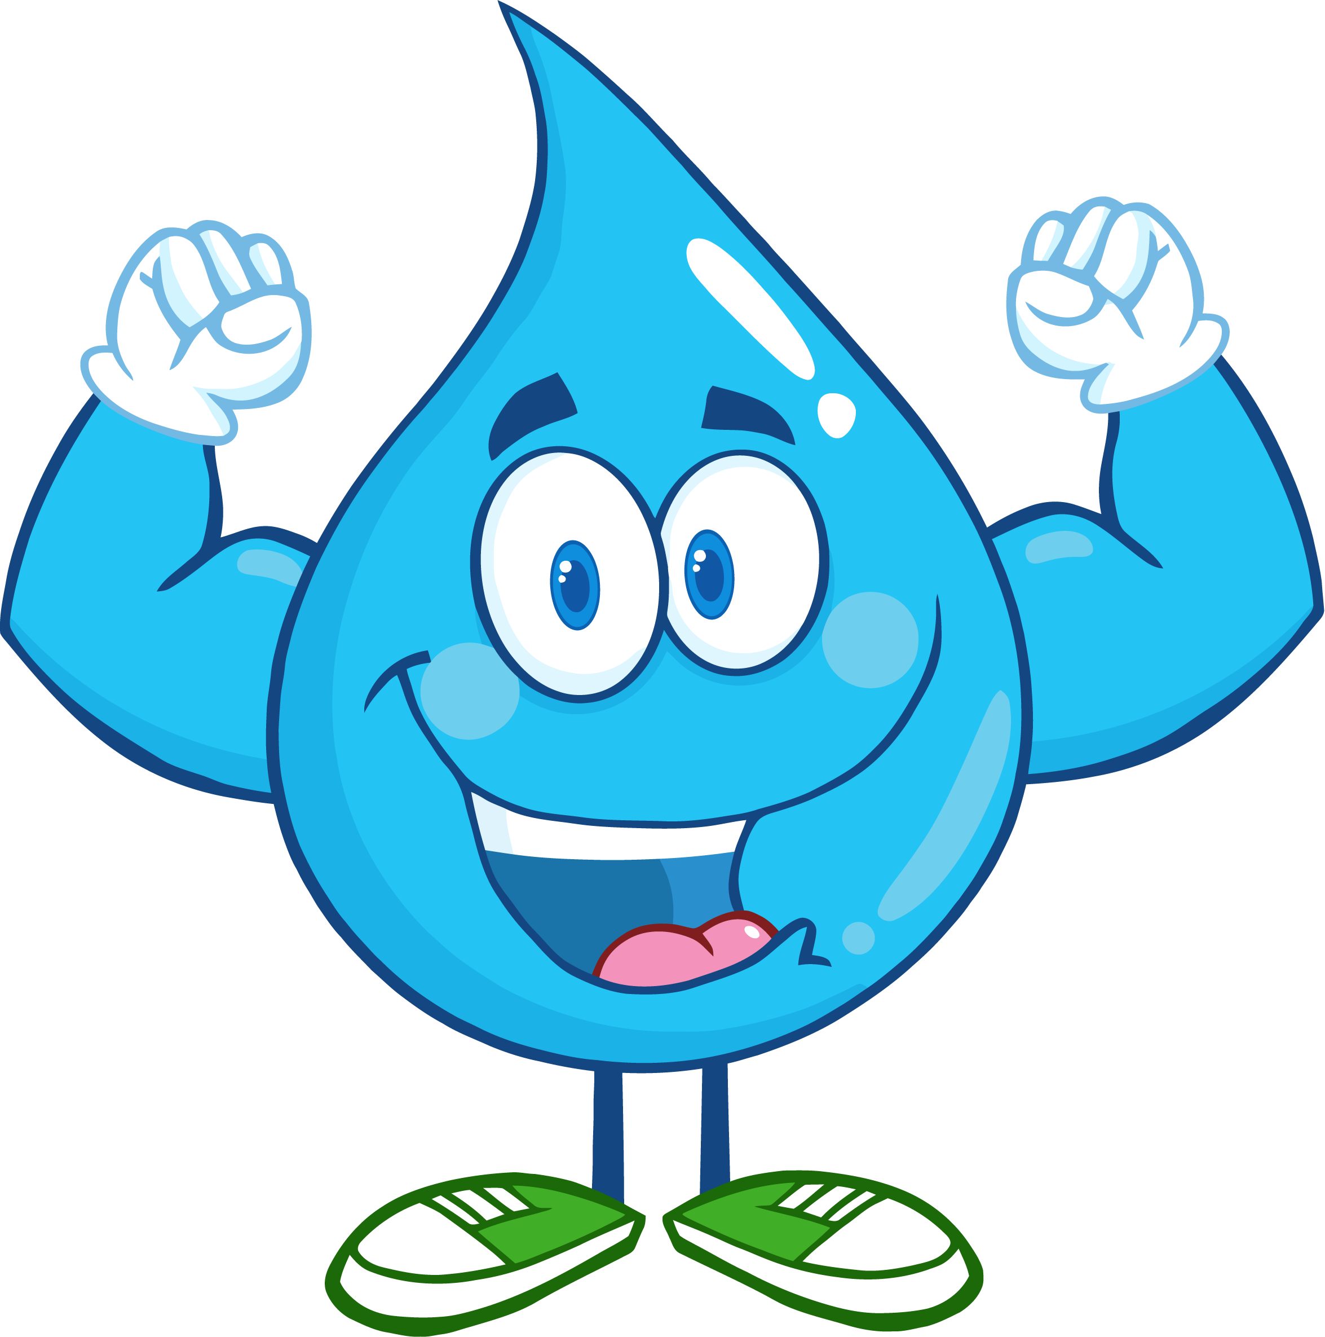
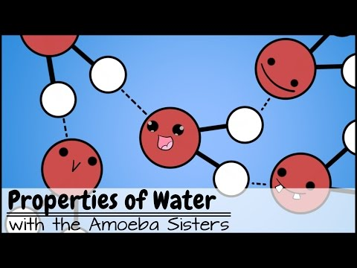
Water _________ temperatures on Earth. Water is a very good "heat bank" because it can ________________ a large amount of heat with only a slight change in its own ___________. Life could not exist in bodies of water if there were drastic changes in temperature. Temperatures on land are stabilized by bodies of water. Large bodies of water _______ heat from the sun during the day, _______ landmasses. Large bodies of water ________ heat at night _________ the landmasses. This stabilizes temperatures on land as well as in the water.
Water is the solvent of life. Water is able to:
stabilizes
absorb or release
temperature
dissolve a wide variety of substances.
absorb
cooling
release
warming

Slide 27
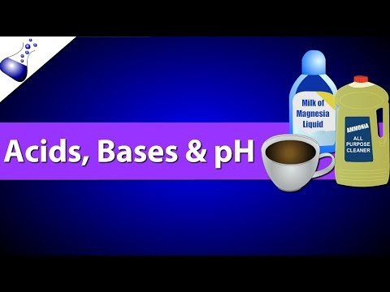
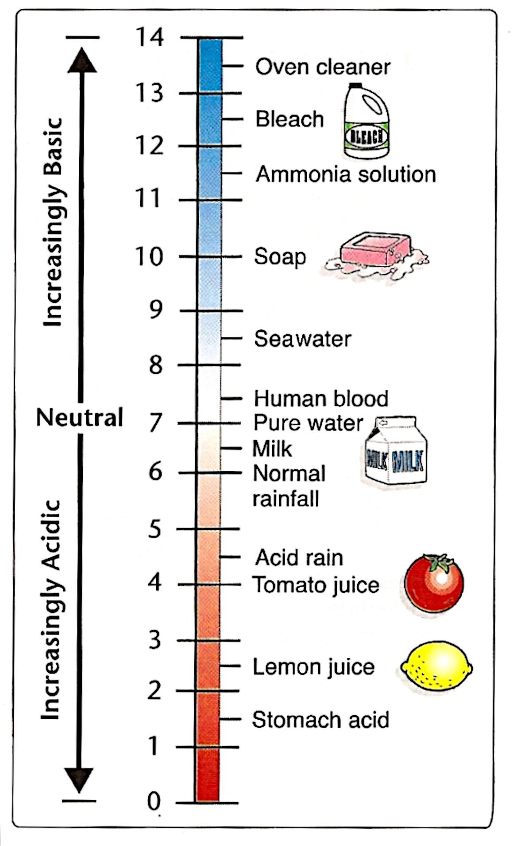
Acids, Bases, and pH
The pH scale is a measurement system used to indicate the concentration of H⁺ ions in a solution.
The pH scales ranges from _________.
0 to 14
neutral
A pH of 7 is a _________ solution. This is neither acidic nor basic. Pure water has a pH of 7.
Solutions with a pH below 7 are considered ______.
acidic
Solutions with a pH above 7 are considered ______.
The pH scale
basic

Slide 28
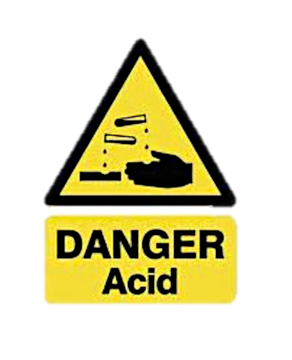
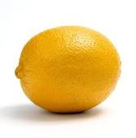
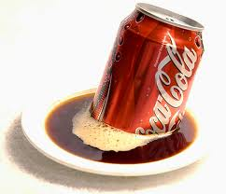
Acid:
Any compound that forms H⁺ ions in a solution.
Acidic
Solutions:
Have a greater H⁺ ion concentration than pure water.
Acids have a pH of below 7.
Examples include: lemon juice, tomato juice, carbonated drinks, vinegar

Slide 29
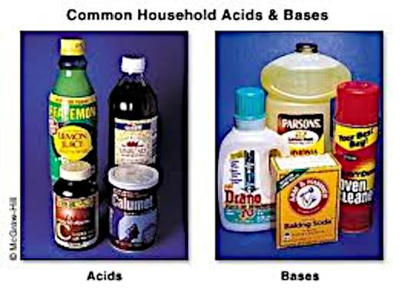
Base:
Any compound that forms OH– ions in a solution
Basic Solutions:
Have a lower H⁺ ion concentration than pure water
Bases have a pH of above 7
Examples include: ammonia, soaps, bleach, sodium bicarbonate.

Slide 30
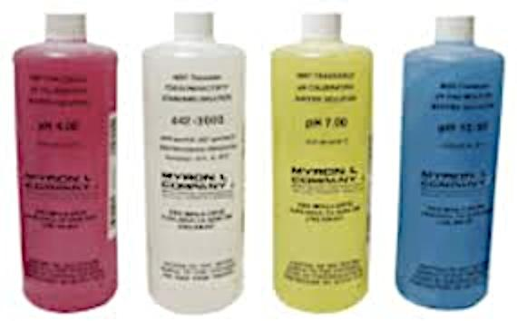
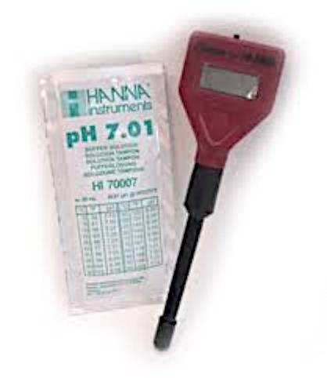
Buffers
The pH of most human cells should generally be between 6 and 8.
If the pH gets too high or too low, it affects the chemical reactions that take place within cells.
Cells must be able to control their pH.
Buffers are substances produced by cells that prevent sharp, sudden changes in pH.

Slide 31

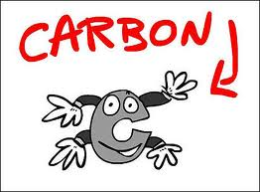
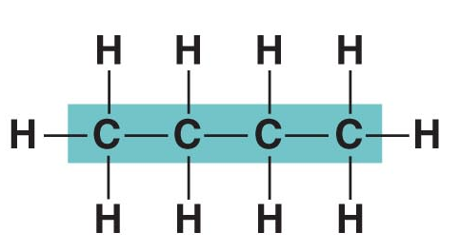
Carbon Compounds
Compounds that contain carbon atoms bonded to other carbon atoms.

Slide 32
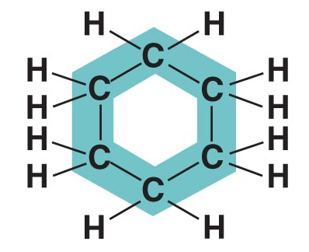
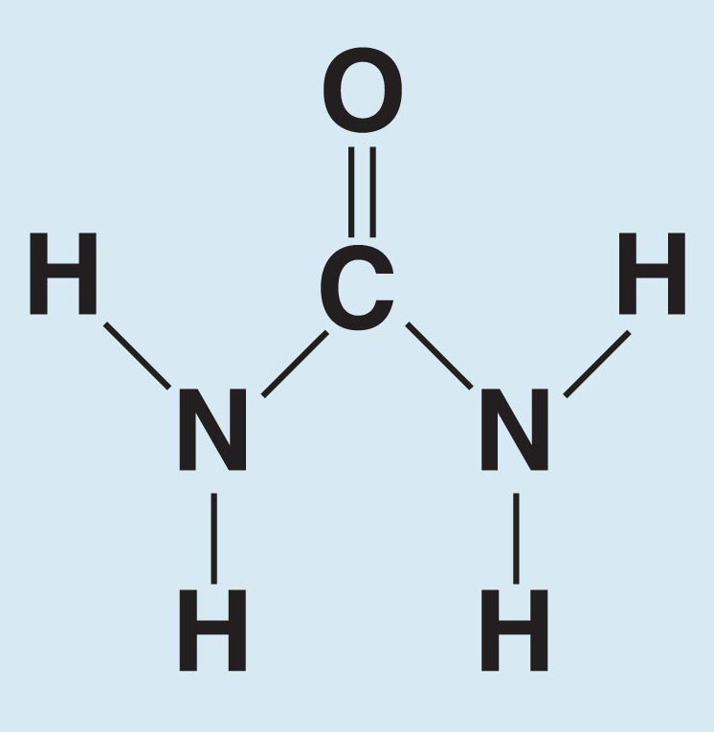

Characteristics of Carbon Include:
Carbon forms strong and stable bonds.
Carbon can form bonds with other ___________ as well as a variety of ____________ such as ______________________
_________________.
carbon atoms
other elements
oxygen, hydrogen, nitrogen,
sulfur and phosphorus
Carbon can form chains that are almost unlimited in size. Carbon can form chains or rings.

Slide 33


Macromolecules
Many of the molecules in living cells are so ______ that they are known as _______________. This means “______________”.
large
macromolecules
giant molecules
The four groups of organic compounds found in living things are:
Macromolecules are made from thousands of smaller molecules.
Carbohydrates
Lipids
Proteins
Nucleic Acids

Slide 34



Characteristics of Carbohydrates
C₆H₁₂O₆
These compounds are made up of
___________________________
in a ratio of _____.
carbon, hydrogen and oxygen
1:2:1
Look at the top picture. Count the number of carbon atoms you see.
C₆H₁₂O₆
Now count the number of hydrogen atoms you see.
Finally, count the number of oxygen atom you see. What is the formula?
C₆H₁₂O₆
Now do the same thing for the bottom picture.

Slide 35


Examples of carbohydrates are:
sugars, starches, and celluloses.
The carbohydrates are known as the “quick energy” foods because they are very quickly converted to energy by the cells.

Slide 36


There are two main functions of carbohydrates:
Living things use carbohydrates as their main source of energy.
2. Some plants and animals use carbohydrates for structural purposes.
The smaller molecules that make up the carbohydrates are…...
…..simple sugars such as glucose.

Slide 37





The Sugars
Carbohydrates are classified according to …
…the number of sugar molecules they contain.
Monosaccharides
Disaccharides
Polysaccharides
Disaccharides are composed of 2 molecules of sugar bonded together.
Monosaccharides contain only one molecule of sugar.
Polysaccharides are composed of many molecules of sugar bonded together.

Slide 38
Three Common Polysaccharides
Glycogen
Starch
Cellulose
Only found in animals.
Only found in plants.
Cellulose is the stringy, fibrous material found in the cell wall of plants.
This is the way that plants store excess glucose.
This is the way that animals store excess glucose.
It gives strength to the plant cell wall.
Many, many molecules of glucose are bonded together to form starch.
The liver bonds together many, many molecules of glucose to form glycogen.
Cellulose is the major component of wood and paper.

Slide 39




Lipids
Examples of lipids are fats, oils, and waxes.
These compounds are
generally not soluble in
water.
Lipids contain the elements ______, ___________________, but not in the _____ ratio seen in the sugars.
carbon
hydrogen and oxygen
1:2:1
There are two building blocks of lipids: fatty acids and glycerol

Slide 40


A lipid has one molecule of glycerol and three fatty acid tails.
<-fatty->
acid
<-fatty->
acid
<-fatty->
acid
glycerol
glycerol
Circle and label the glycerol molecule in each of the above drawings.
Label the three fatty acid tails in each drawing.

Slide 41
A lipid has one molecule of glycerol and three fatty acid tails.
<-fatty->
acid
<-fatty->
acid
<-fatty->
acid
Unsaturated fat
Saturated fat
carbon-carbon double bond
If a fatty acid tail has at least one _________________________, it is said to be an ____________fat.
unsaturated
carbon-carbon double bonds
If a fatty acid tail has no ________________________, it is said to be a ________ fat.
saturated
Which of these drawings is a saturated fat? Which is an unsaturated fat?

Slide 42




Is this a saturated or an unsaturated fat?
It is unsaturated.
Unsaturated fats tend to be ______ at room temperature. Examples are olive oil and vegetable oil.
liquid
solid
Saturated fats tend to be _____ at room temperature. Examples are:
shortening, lard, or butter.

Slide 43
Uses of Lipids
They are used to store energy.
They are an important part of the cell membrane.
They form waterproof coverings on feathers, fruits, leaves, etc.
They cushion and insulate the internal organs.

Slide 44



Nucleic Acids
Nucleic acids are macromolecules containing the elements…
Carbon, hydrogen, oxygen,
nitrogen, and phosphorus
There are two kinds of nucleic acids: DNA and RNA
The building blocks of the nucleic acids are nucleotides.
Nucleic acids store and transmit genetic information.

Slide 45

Proteins are macromolecules that contain…
…carbon, hydrogen, oxygen and nitrogen.
Proteins
The building blocks of proteins are amino acids.
There are 20 different amino acids.

Slide 46

“R” groups
Carboxyl
amino
One single hydrogen
Each amino acid has four parts. Label these groups on the drawing above.
There are many, many uses for proteins
1. enzymes
2. hormones
3. transport proteins such as hemoglobin
4. contractile proteins such as in muscle tissue
5. antibodies
6. membrane proteins
7. structural proteins such as bones and muscles
Carboxyl group
An amino group
One single hydrogen
An “R” group which is different on every single amino acid.

Slide 47

Facts About Enzymes
Enzymes are proteins that speed up the chemical reactions of the cell.
Enzymes do not cause reactions to happen. They simply speed up reactions that will already occur.
Without enzymes the reactions of the cell would proceed so slowly that the cell would die.
Enzymes are very specific. They can only carry out one job, but they do that one job extremely well.
Enzymes are never used up in the reaction. They can be used over and over again.

Slide 48

How Enzymes Work
Enzyme + substrate → enzyme-substrate complex → enzyme + products
Substrate molecules ---- >
< ---- Enzyme - Substrate Complex
Enzyme ---- >
Active Site ---- >
< ---- Enzyme is unchanged and can be used again.
Substrate molecules: The reactants in the reaction.
< ---- Products
Products: New substances formed as a result of the reaction.
Active Site: Where the substrate molecules bind to the enzyme. The fit is so precise that it is compared to a “lock and key.”

Slide 49

Remember!!
The shape of the enzyme is so specific that only one shaped substrate can fit.
A specific enzyme is required for each reaction in a cell.
There are over 2000 known enzymes.
Enzymes are not used up in the reaction. They are available to do the reaction again.

Slide 50


Slide 51
Reviewing Enzymes! http://www.youtube.com/watch?v=NdMVRL4oaUo
http://youtu.be/1Pe5a4C6KmY
http://youtu.be/CUClhD-lpUA

Slide 52

Making and Breaking Macromolecules!
Dehydration Synthesis & Hydrolysis

Slide 53


Dehydration
(removal of water)
Synthesis
( to make or build)
FILL OUT YOUR NOTES!

Slide 54
Dehydration Synthesis
(removal of water to make, or build)
A molecule of water is removed to build a polymer from monomers
In the picture below, chains of simple sugars are made by DEHYDRATION SYNTHESIS.
Dehydration synthesis takes place when the monomers of organic compounds join together by a chemical reaction to make polymers… they are BONDED after removing water.
HO-
-O-
-O-
-O-
-OH

Slide 55
Dehydration Synthesis
In Dehydration synthesis, we go from small to BIG.
monomer → polymer (+ water)
In dehydration synthesis water is REMOVED (lost) so you will see it on the PRODUCT side of the equation (right).
Enzyme-activated reaction… what does that mean?!
ENZYME ACTIVATED
HO-
-OH
HO-
-OH
HO-
-0-
-OH
H₂0
LOST
+ H₂0
REVERSIBLE RXN

Slide 56

Dehydration Synthesis in Carbohydrates
Two monosaccharide's, such as glucose and fructose can be joined together (to form sucrose, a disaccharide) using dehydration synthesis.

Slide 57

Dehydration Synthesis in Proteins

Slide 58
Explain
Illustrate
Explain the process of dehydration synthesis in your notes!
After one minute, share with your neighbor and improve your explanation!
Draw an image of dehydration synthesis from the board!

Slide 59

HOW CAN YOU BREAK?
predict what steps must be taken in order to break apart the polymer into monomers.

Slide 60


FILL OUT YOUR NOTES!
Hydro
(water)
Lysis
(to break)

Slide 61
Hydrolysis
(adding water to break apart)
Hydrolysis is the process of breaking down large molecules by adding WATER!
Hydrolysis takes place when the polymers of organic compounds are broken down by a chemical reaction to make monomers… the bonds are broken between monomers with the help of water.
Water is a REACTANT , so it will be found on the left of the equation.
HO-
C
---0---
C
-OH
_{Add} _{H2O}
ENZYME ACTIVATED
HO-
C
-OH
H-
C
-OH
2 glucose molecules

Slide 62

Hydrolysis
(adding water to break apart)
Hydrolysis is big to small
POLYMER → MONOMER
In humans, hydrolysis is happening when we DIGEST our food! Living organisms must break down carbohydrates, proteins and lipids in order to utilize them. ****Must be small enough to fit in the CELL!
**think of power-washing a driveway…. Add water to break apart the dirt!

Slide 63

Hydrolysis in Carbohydrates
What is that?

Slide 64
Explain
Illustrate
Explain the process of hydrolysis in your notes!
After one minute, share with your neighbor and improve your explanation!
Draw an image of hydrolysis from the board!

Slide 65

In Conclusion…..
Dehydration Synthesis: Builds molecules by removing water
(putting monomers back together in our cells so we can use them properly!)
Hydrolysis: Breaks apart molecules by adding water
(digestion of the biomolecules we eat)

Slide 66
DEHYDRATION SYNTHESIS
HYDROLYSIS
DEHYDRATION:
SYNTHESIS:
Explain the process of dehydration synthesis:
Illustrate the process of dehydration synthesis of a polymer. (LABEL!)
HYDRO:
LYSIS:
Explain the process of hydrolysis:
Illustrate the process of hydrolysis of a monomer. (LABEL!)

